Slide 1



adhikaribinay77.com.np
GIT & GITHUB FOR
BEGINNERS
NEPTECHTRIBE
August 20, 2024

Slide 2

adhikaribinay77.com.np
August 20, 2024

Slide 3
GIT is a Version Control System that helps to track changes in the code.
GIT is :
Popular
Free & Open source
Fast and Scalable

Slide 4
A FEW USE CASES:
KEEP A HISTORY OF PREVIOUS VERSIONS
Develop simultaneously on different branches
Easily try out new features, integrate them into production or throw them out
Collaborate with other developers “Push” and “pull” code from hosted repositories

Slide 5
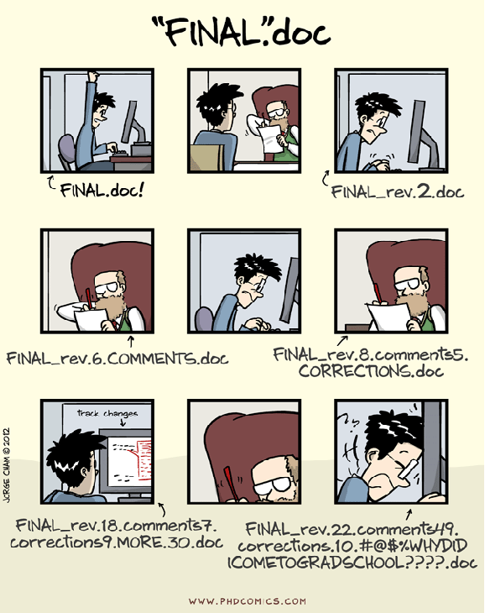
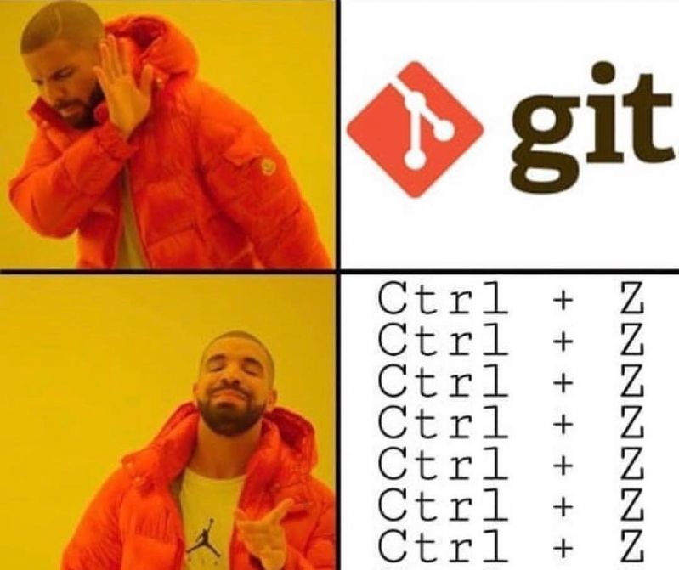

Slide 6

Git History
Came out of Linux development community
Linus Torvalds, 2005
Initial goals:
Speed
Support for non-linear development (thousands of parallel branches)
Fully distributed
Able to handle large projects like Linux efficiently

Slide 7
What is Github?
GitHub was developed by Chris Wanstrath, P. J. Hyett, Tom Preston-Werner and Scott Chacon using Ruby on Rails, and started in February 2008
It is a subsidiary of Microsoft, which acquired the company in 2018 for $7.5 billion
GitHub.com is a site for online storage of Git repositories.
You can get free space for open source projects or you can pay for private projects.

Slide 8
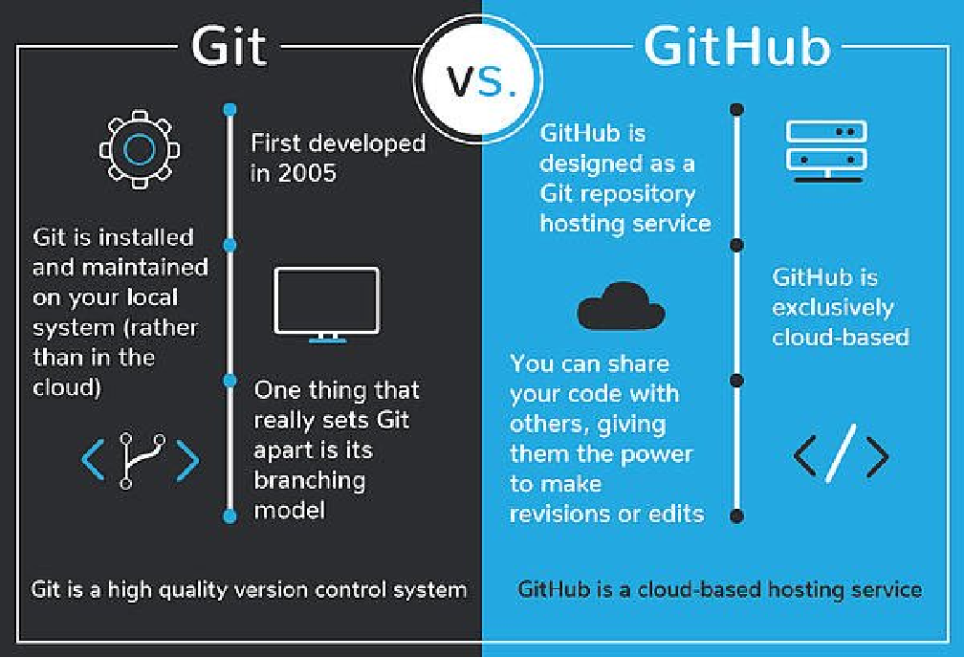

Slide 9
GITHUB
Create a Github Profile:
https://github.com/

Slide 10

GITHUB

Slide 11


Slide 12
GITHUB Account
Create a new repository(repo): Neptechtribe-demo
Make a first commit

Slide 13

Setting up GIT
Download and install Git
Setting up GIT
VS code (https://code.visualstudio.com/Download)
Windows Git Bash (http://git-scm.com/downloads)
Mac (Terminal)

Slide 14
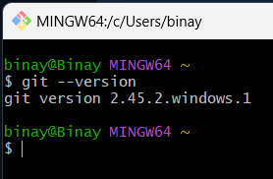
Check if download went well or not
git --version

Slide 15

CONFIGURING GIT
git config --global user.name “your username”
git config --global user.email “your email” This email should be registered in your GitHub
git config --list

Slide 16
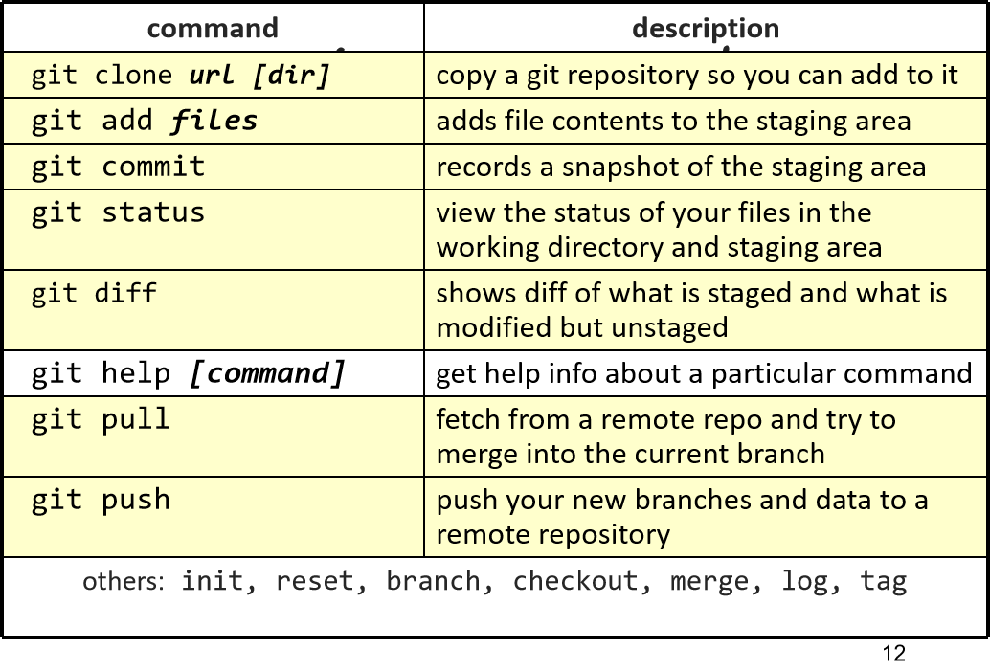

Slide 17

Git Clone and Git Status
Clone: Copy remote repository to a local system,
git clone --(repo URL)
Status: Display the status
of a code
git status

Slide 18

Git Status
Untrack: new file that git doesn’t yet track
Modified: Changed
Staged: File is ready to be committed
Unmodified : unchanged

Slide 19
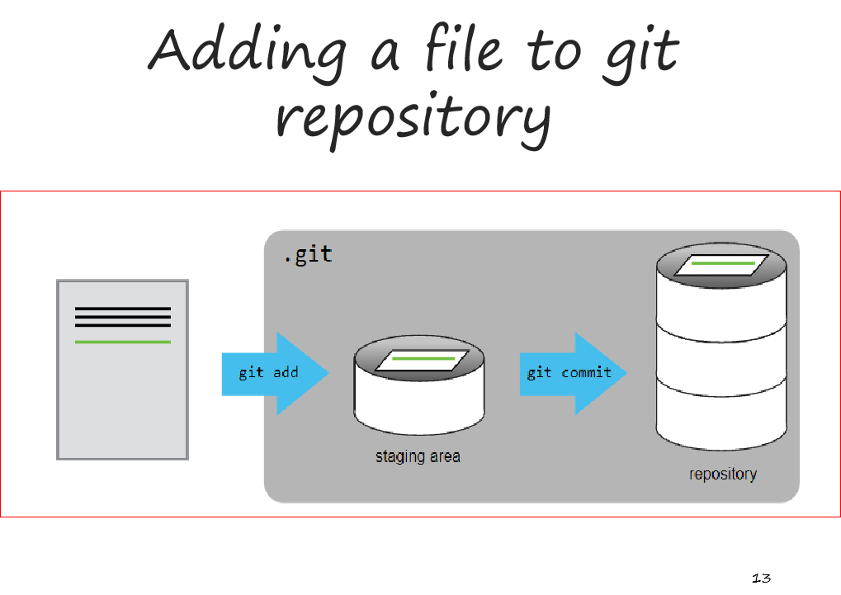

Slide 20
Git add and Git commit
add: add new or changed file on working directory to staging area,
git add <filename> or
git add .
commit: keeps the record
of a code. git commit -m “commit-message”

Slide 21
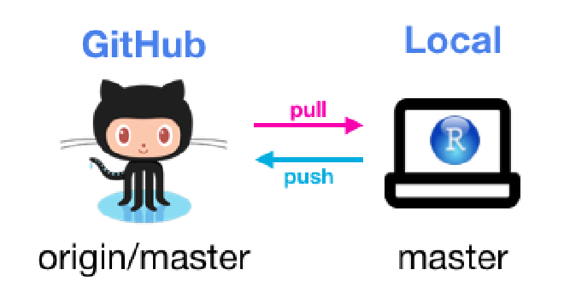
Git Push
Push: add new or changed file on working directory/ local repo to remote repo,
git push origin main

Slide 22

Git Init
Init: used to create a new remote repo / initialize git...
git init
git remote add origin <link-to-remote>
git remote -v (to verify remote)
git branch (to check branch)
git branch -m main (rename branch)
git push origin main

Slide 23
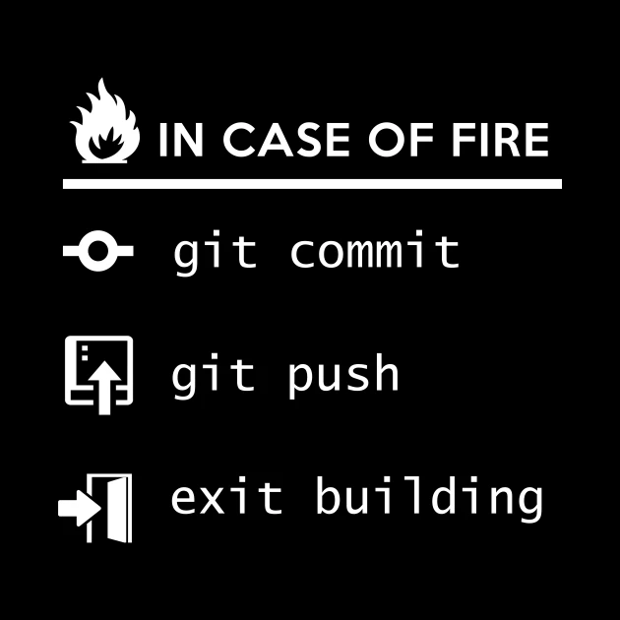



Slide 24
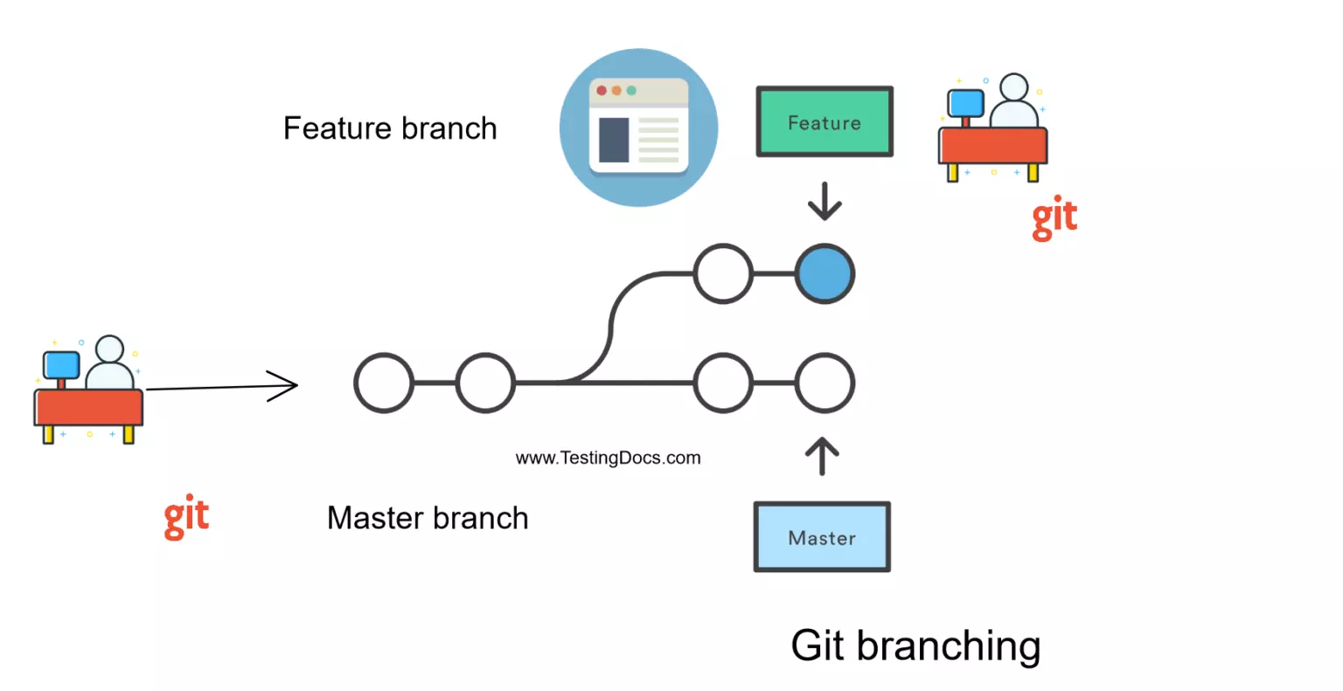
Git Branches

Slide 25

Git Branches
git branch (to check branch)
git branch -M main (to rename branch)
git checkout <-branch name-> (to navigate)
git checkout -b <-new branch name-> (to create new branch)
git branch -d branch name (delete branch)

Slide 26
Git
Merge
git diff <-branch name->
(to compare commits, branches, files)
git merge <-branch name-> (to merge 2 branch)
create a pull request
Git
Pull
* git pull origin main (fetch and update local repo as per remote repo)

Slide 27

Fork
A fork is a new repo that shares code and visibility settings with the original “upstream” repository.
fork is basically a rough sketch.

Slide 28

THANK YOU
BINAY ADHIKARI
-neptechtribe - 8-20-2024

